Slide 1

Web app NLP
Daniel Suárez

Slide 2

THE Challenge
We want to you to create a web UI where you call an API that uses NLP to analyze, summarize and extract important information from news articles. This challenge should be solved using Python, you can choose the framework that best suits you.

Slide 3

Challenge Accepted
https://github.com/jdsuarezj/wj_developerchallenge

Slide 4

Features
Django
Modular design template
Python 3
Bootstrap css
SQLite fake DB
Aylien API

Slide 5
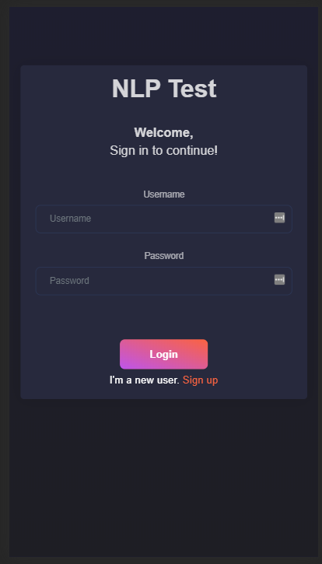
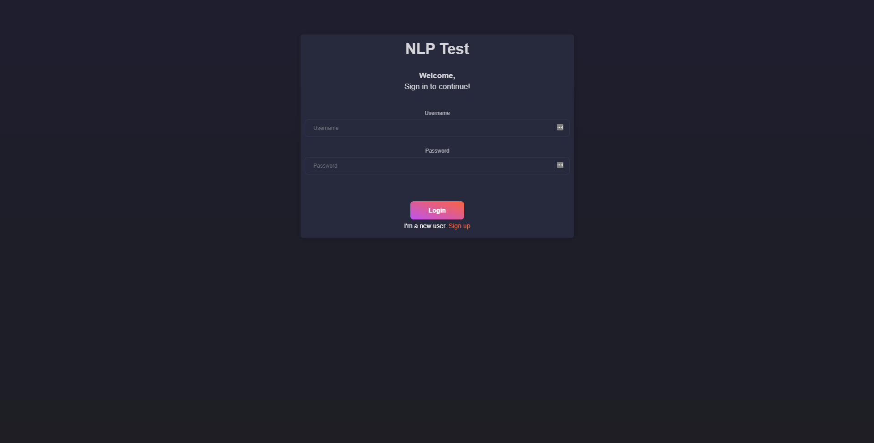
Part 1
User creation and login
Login
Mobile
Desktop
View designed for authentication and as initial screen.
Authentication with Django middleware without handling errors or alerts.

Slide 6
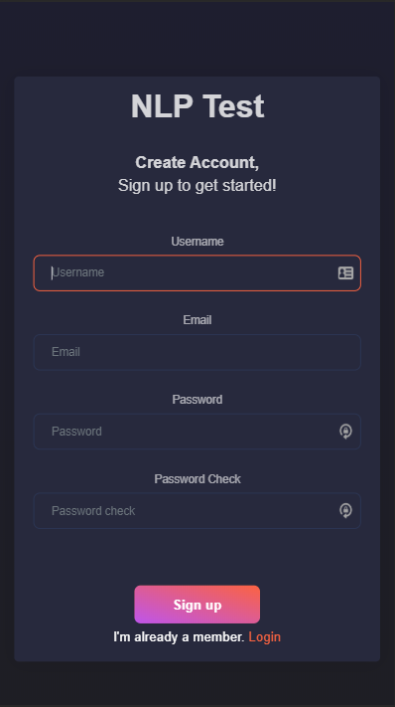
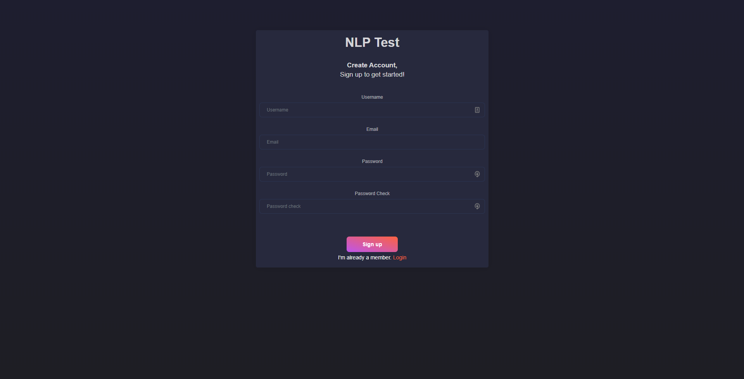
Part 1
User creation and login
Sign up
Mobile
Desktop
User creation and validation view.
Authentication with Django middleware without handling errors or alerts.

Slide 7
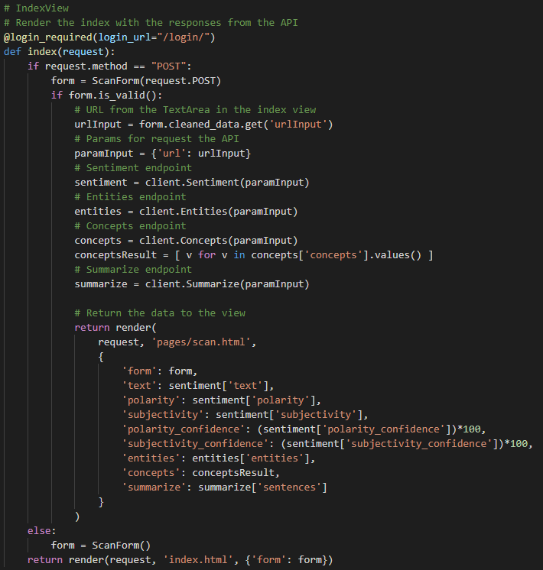
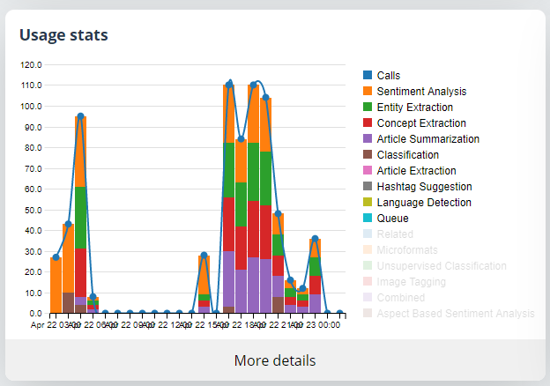
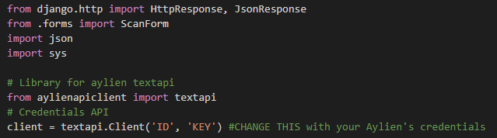
Part 2
Connect to Text API
Aylien - Python SDK
3. API Requests for each endpoint
1. Aylien account
2. Library installation from the requirements
3. Import and config the API

Slide 8
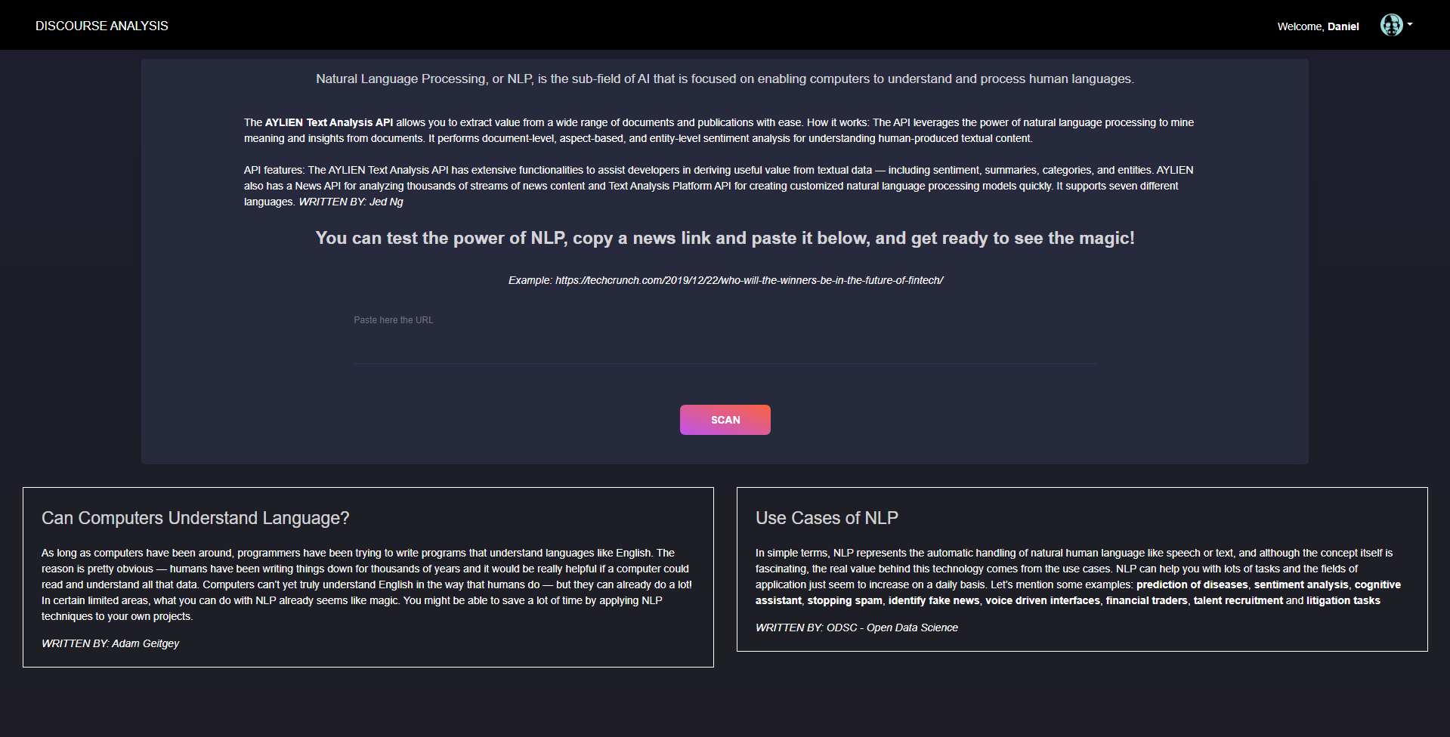
Part 3
Build UI
Home
Where the user enters the URL.
In this view it is explained that it is NLP, which is Aylien. It is displayed clearly and easy to use and with a single button. Also, some author references are left talking about NLP and its benefits.

Slide 9
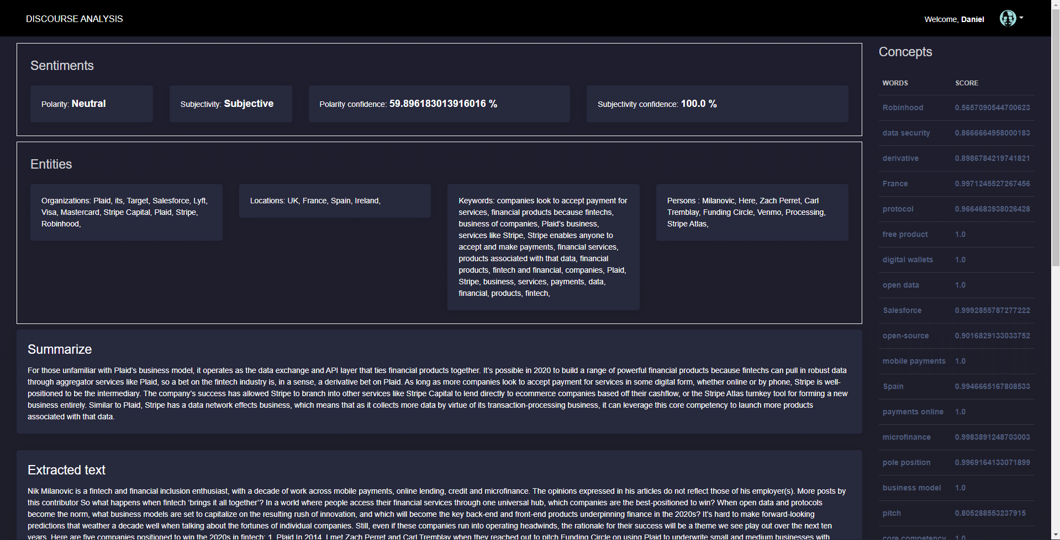
Part 3
Build UI
Scan
Where is the analysis.
The article analysis is shown in an orderly and easy to understand way. The classification endpoint presented errors with some articles.

Slide 10
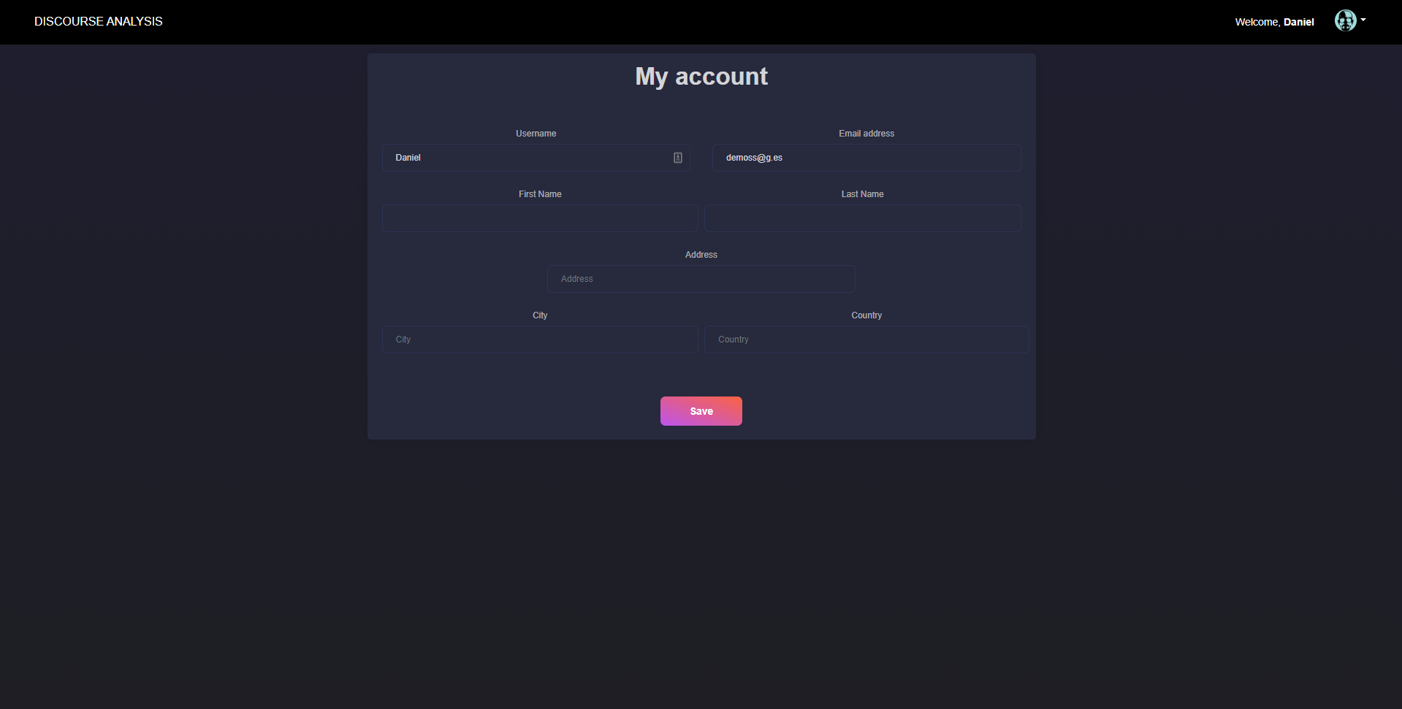
Part 3
Build UI
Extra: User profile
A quick layout of the fake user profile page.

Slide 11

GRACIAS
Daniel Suárez
jdsuarezj@unal.edu.co

